Slide 1
Pediatric Surge Annex Tabletop Exercise
Coalition Name
Date
Template provided by:

Slide 2
Instructions for Use of this PPT Template – Delete this slide prior to presentation
Edit these slides based on changes made by the Exercise Planning Team to the Situation Manual Template.
Language and information included here is based on the template design and template sample language.

Slide 3
Welcome and Introductions
Name
Agency / Facility
[Add coalition or jurisdiction logo or seal to customize]

Slide 4
Agenda
Time | Topic
8:00 AM – 8:30 AM | Introductions and opening remarks
8:30 AM – 9:00 AM | Overview of exercise and Pediatric Surge Annex
9:00 AM – 9:40 AM | Module 1 – Initial Incident
9:40 AM – 10:00 AM | Module 2 – first two hours
10:00 AM – 10:10 AM | BREAK
10:10 AM – 10:30 AM | Module 2 cont.
10:30 AM – 11:10 AM | Module 3 – 4 hours out
11:10 AM – 11:50 AM | Module 4 – 5+ hours out (Optional Module)
11:50 AM – 12:30 PM | Wrap Up and Hotwash
Notes:
Today’s event has two purposes. We will provide a brief overview of the HCC Pediatric Surge Annex Plan to ensure all players have a general understanding of its content. Then we will conduct a tabletop exercise (TTX). The TTX is comprised of four modules consisting of an initial incident and then the subsequent aftermath. Players in this exercise will participate in the following exercise module elements:
Module 1 – Initial Incident Period and Facility Response
Module 2 – Community Coordination
Module 3 – Transfer/Transport Coordination
Module 4 – Family Reunification and Support
Each module begins with a scenario update that summarizes the key events occurring within that time period. A series of questions following the scenario summary will guide the facilitated discussion of critical issues in each of the modules. Based on exercise priorities, time dedicated to each module will be managed by the facilitator.
Planning Note: Planners may change the event or the scope as needed to fit local considerations. Scenarios should still follow the modular approach in this sample.

Slide 5
Administrative Details
Restrooms
Fire Exits
Cell Phone Use
Materials

Slide 6
Introduction to HCC Pediatric Surge Annex
Goal
Scope
Purpose
[Slides 6-8 describe the HCC Pediatric Surge Annex and must be filled in by the exercise planning team based on the specific information in the HCC annex. Feel free to add additional slides to the briefing.]

Slide 7
Planning Assumptions
[To be completed by the Exercise Planning Team]
[The plans may be in evolution / draft at this point – the attendees should understand that this exercise is designed to help explore, validate, and deconflict the pediatric plans in place. We don’t expect to have all the answers at this point]

Slide 8
Triggers or Coalition Specific Response Steps
[To be completed by the Exercise Planning Team]
[Describe the thresholds or potential triggers for annex use, as well as the specifics of the response by the coalition members / disciplines]

Slide 9
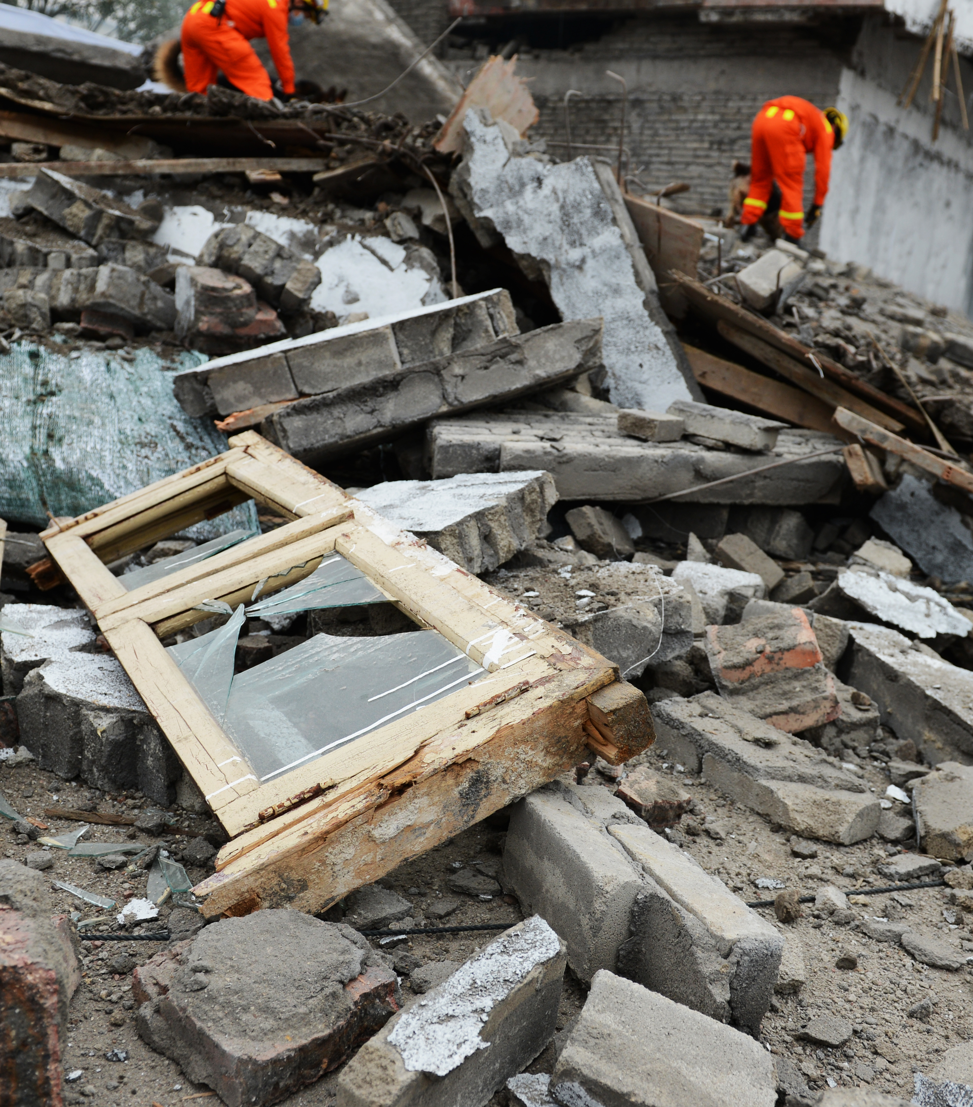
Tabletop Exercise
Pediatric Surge Annex

Slide 10
Exercise Scope
This TTX is an interactive, discussion-based exercise focusing on impacts to healthcare coalition and healthcare facilities caused by mass casualty events with large numbers of pediatric patients.

Slide 11
Capabilities Tested
Capability 2: Health Care and Medical Response Coordination
Objective 1: Develop and Coordinate Health Care Organization and Health Care Coalition Response Plans
Capability 3: Continuity of Health Care Service Delivery
Objective 6: Plan for and Coordinate Health Care Evacuation and Relocation
Capability 4: Medical Surge
Objective 1: Plan for a Medical Surge
Objective 2: Respond to a Medical Surge
[Add or change based on exercise planning at the HCC level]

Slide 12
Exercise Objectives
Review existing pediatric care assets and identify gaps that may occur in a pediatric mass casualty incident.
Review agency/facility role in a pediatric mass casualty incident.
Validate assumptions in the HCC Pediatric Surge Annex.
Identify changes that need to be made in the HCC Pediatric Surge Annex based on the roles and capabilities of the involved partners.
[Other objectives identified by the Exercise Planning Team.]

Slide 13
Guidelines
Open, low-stress, no-fault discussion environment.
Comments will be non-attribution.
Responses should be based on knowledge of current plans and capabilities. You don’t have to have all the answers.
Decisions are not precedent setting.
Problem-solving efforts should be the focus – more questions than answers may be generated.
The situation updates, written material, and resources provided are the basis for discussion.
Participants are encouraged to use the SitMan as a reference and to fill out the Participant Feedback Form as you go; feedback is welcome!
Use notes pages available in the SitMan.

Slide 14
Assumptions and Artificialities
During this exercise, the following apply:
The scenario for this exercise is artificial, however, it is plausible, and events occur as they are presented.
There are neither “hidden agendas” nor any “trick questions”
All players receive information at the same time
Assume cooperation and support from other responders, agencies, and organizational entities

Slide 15
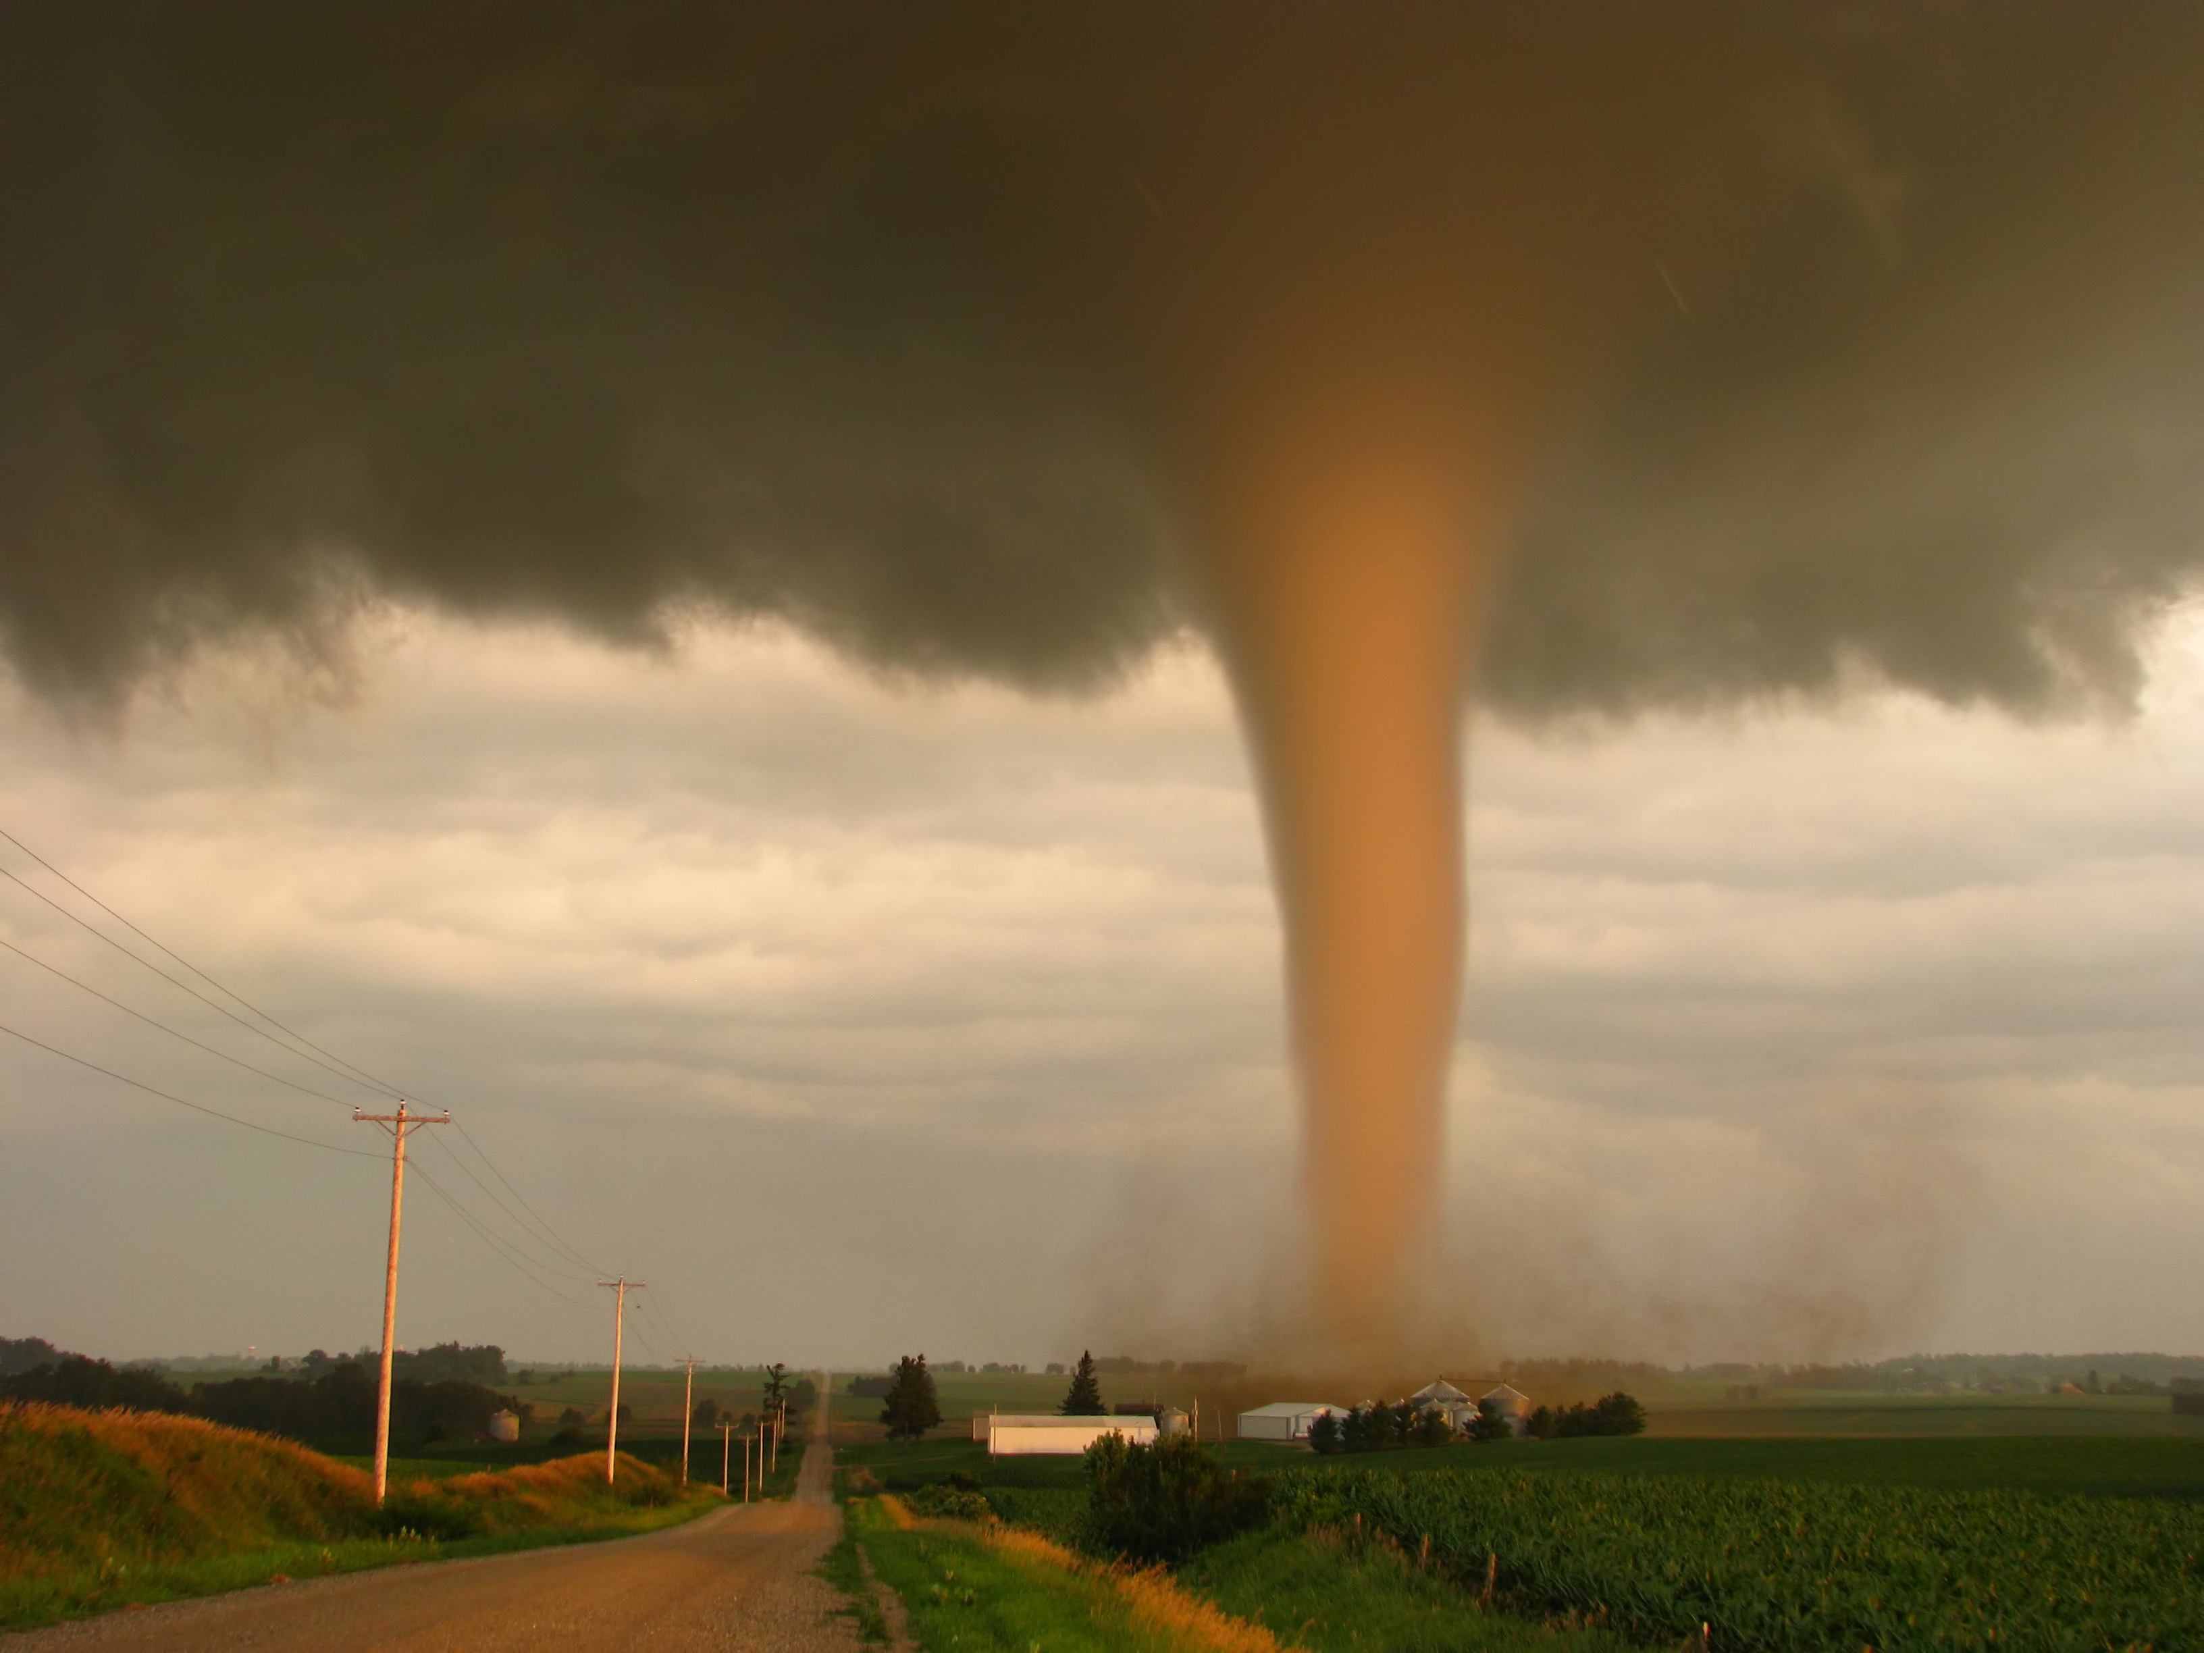
Module 1
Monday afternoon, May 10, 12:00 pm
Your hospital is at normal staffing, supply, and patient levels.
Hospitals in the area are full due to a late viral illness season.
Heavy thunderstorms are in the area and a tornado has touched down with structural collapse at an elementary school six blocks from your hospital.
A few minutes later, a minivan pulls up with two critically injured 5-year old children and several older children with minor injuries.
The first ambulances arrive at your facility and another private vehicle just pulled up with another critically injured 7-year-old and several children with injuries from broken glass that are crying.
Additional adult patients begin arriving by ambulance.
Notes:
NOTE to Facilitator: Provide the situation update, then direct each group to discuss among themselves and assign one person to take notes and report back to the main group.

Slide 16
Module 1 Discussion Questions
What are your initial actions upon notification of this incident? What do you need to do to activate your disaster plan? Do you have a pediatric surge plan? If yes, how is it activated?
How many pediatric patients is your facility prepared to handle?
Do you provide pediatric inpatient care?
What supplies do you have on-hand to manage pediatric patients?
What staff do you have on-hand to manage a surge of pediatric patients?
Are your staff (including any pharmacy staff) comfortable with pediatric dosing of medication?
What pediatric training does your hospital emergency department staff have?
Are you prepared to handle unaccompanied minors, including supervision and consent to treat decision making?
What changes to your facility disaster plan are needed to accommodate a pediatric surge?
In the event that your facility’s pediatric capacity is exceeded, or you do not provide pediatric trauma services, how would you address referring these cases to a larger and/or pediatric hospital?
What is the current referral process for a critically ill child and how would this change in this incident?
How would you prioritize/triage multiple pediatric referrals from your facility?
Does your facility have written agreements with pediatric and trauma referral centers to expedite patient transfer?
What patient transportation resources would you need?
Notes:
Note this discussion module is focused on EMS and hospital clinical care – PH and EM should concentrate on question 1 and 3.
This is intended to be a progressive exercise starting with an individual facility and progressing to coalition-wide management.

Slide 17
Module 1 Report Out
Each table provide top 3 lessons, due outs, action items.
Provide the rest of your notes to the exercise facilitator.

Slide 18
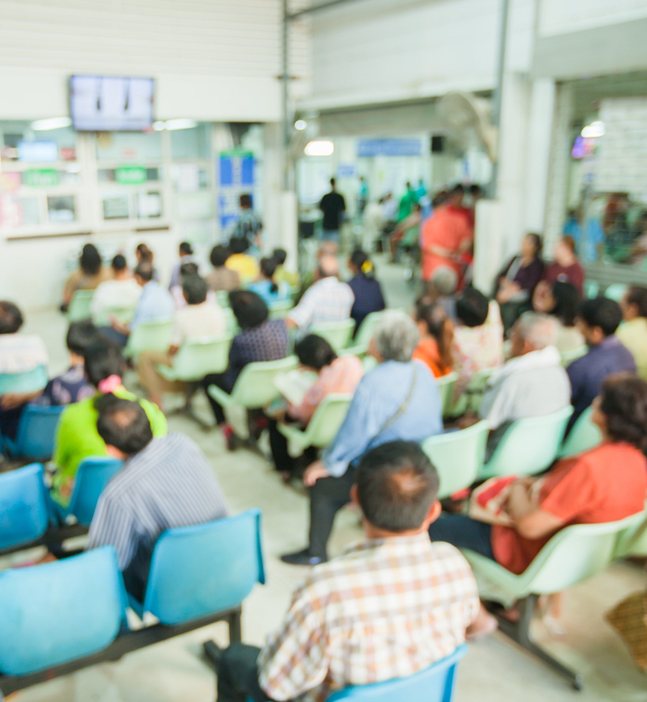
Module 2
Monday afternoon, May 10, 2:00 pm (Incident + 2 hours)
You have now received significant numbers of patients and your surge capacity has been exceeded.
Due to the large number of pediatric patients affected and current high census, your usual referral children’s hospital cannot accept all inter-hospital transfers.
You must stabilize and treat the pediatric patients at the local hospitals for now aside from the patients that are critically injured.

Slide 19
Module 2 Discussion Questions
What alerts and notification mechanisms are in place to ensure that the coalition partners are aware of the incident?
How does the HCCsupport this response?
If the coalition has an operations center how is this activated, staffed, and what functions does it serve? How does it interface with the EOC?
If the coalition functions are conducted by/at the jurisdictional EOC how rapid is the activation? Who provides coordination and supports the healthcare needs?
What type of assistance (staff, space, resources, systems) could the HCC and its members provide? Are there other partners that you should coordinate with? Is this different from ESF-8 support?
When would you notify and request assistance from emergency management (if at all)?
What emergency medical services (EMS) transport resources are available (both public safety or private services)? (For EMS to discuss – consider both ground and air assets)
Where would you obtain guidance or clinical advice for pediatric patient surge care prior to and during an event? What types of pediatric or other experts might be needed that are not yet included? How do you communicate with them (e.g. telephone/telemedicine)

Slide 20
Module 2 Report Out
Each table provide top 3 lessons, due outs, action items.
Provide the rest of your notes to the exercise facilitator.

Slide 21
Module 3
Monday afternoon, May 10, 4:00 pm (Incident + 4 hours)
Multiple pediatric patients have been treated at area hospitals and require secondary transfer for ongoing care. Some will be accommodated at children’s hospitals, some at trauma centers, and some will need to be cared for locally until capacity improves (beds become available).
Closed roads and transportation difficulties may prevent patient movement.

Slide 22
Module 3 Discussion Questions
How does the HCC Coalition Pediatric Surge Annex address this kind of scenario?
How will the team coordinate sharing patient information across multiple facilities?
How can the coalition ensure patient load balancing among hospitals or play a role in transfer decisions? How will hospitals and EMS coordinate this decision making?
Who will be responsible for prioritizing patient transfers and what criteria will be used to make that determination?
How will transportation be coordinated for these patients?
What is the mechanism for tracking these patients (and keeping them with their parents/guardians or supervising unaccompanied minors) through the referral process?
What resources does your facility have onsite if you need to provide ongoing care instead of transferring a critical pediatric patient? If on-site staff would be required to care for these patients, is there a staff sharing mechanism or agreement(s) to support this? Are telemedicine capabilities available? Has a common point of contact been identified for clinical advice?

Slide 23
Module 3 Report Out
Each table provide top 3 lessons, due outs, action items.
Provide the rest of your notes to the exercise facilitator.

Slide 24
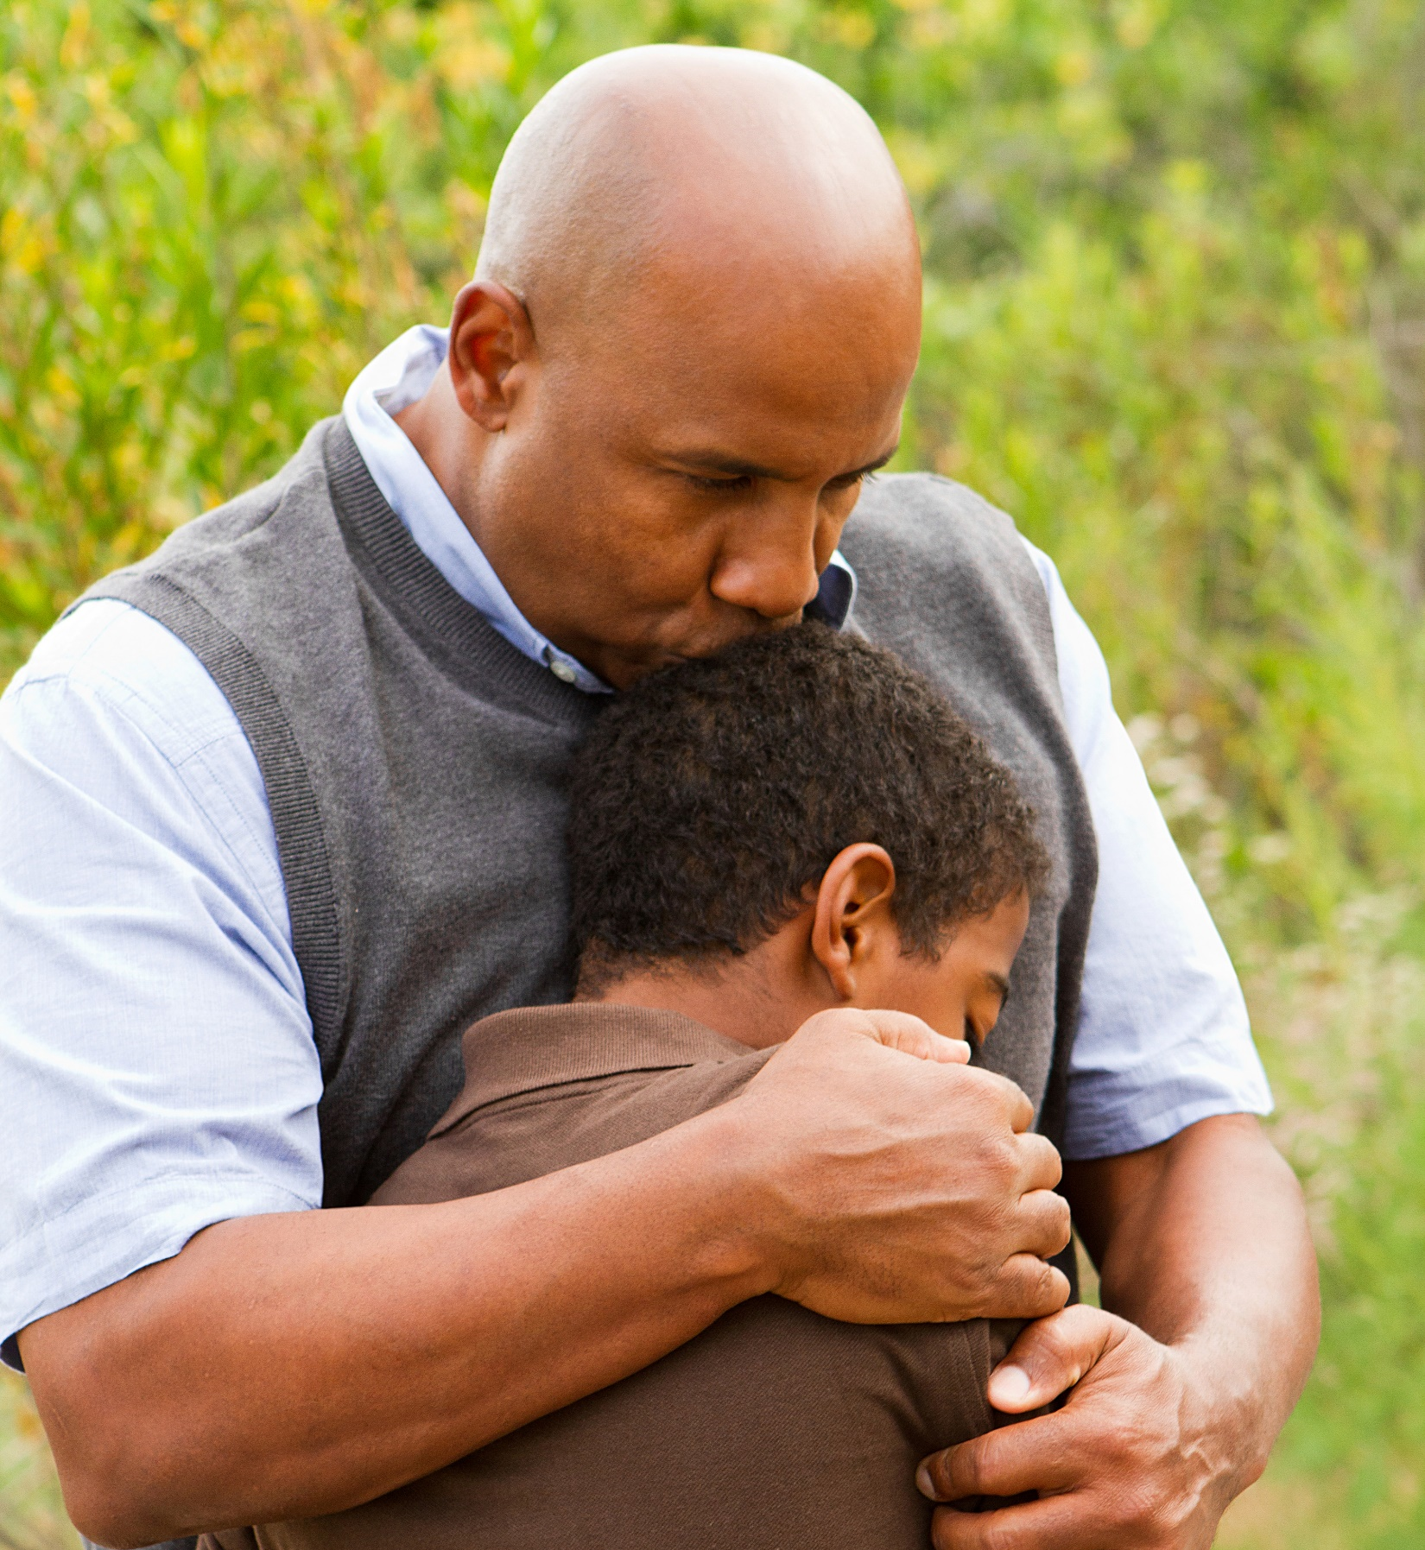
Module 4
Monday afternoon, May 10, 5:00 pm (Incident + 5 hours)
Families have been seeking information on their children and loved ones at hospitals across the region since shortly after the tornado. Some fatalities at the scene have been reported and at least one child has died in transit to a referral center.
Members of the media have arrived at all area hospitals and are seeking information on patient names and conditions.

Slide 25
Module 4 Discussion Questions
What is the hospital plan for family support and reunification?
What role would the HCC serve in multi-hospital reunification efforts?
What media messaging coordination is being done? Who is involved in this activity?
Are there additional steps that should be taken within the hospital to ensure patient safety and security during a mass casualty event with a high number of pediatric patients?
Will your discharge waiting area for unaccompanied minors be secure and supervised by security and hospital staff?
What is the process for parent/caregiver reunification?
What is the interface between hospital and community (agency) reunification efforts?
What are the immediate behavioral health and support needs for parents, caregivers, and children, and how would facilities and the coalition plan to address these?
Notes:
Answers to these questions can focus on facility response, coalition response, and community response.
Specific to a school response, the daily attendance records and visitor sign in logs could be used to facilitate patient tracking.

Slide 26
Module 4 Report Out
Each table provide top 3 lessons, due outs, action items.
Provide the rest of your notes to the exercise facilitator.

Slide 27
Wrap Up
Closing comments

Slide 28
Hotwash
Immediate feedback from participants
One positive about the exercise (something you learned, something you can implement immediately)
One item of correction or action from the exercise (something you would like to take back for immediate action)
Participants should fill out the Participant Feedback Form and submit it before they leave TODAY.

Slide 29
Next Steps
[Suggested Next Steps]
Compile notes and comments, and produce an After Action Report and Improvement Plan
Share Improvement Plan with coalition members and any entity with an action item
Implement action items in the Improvement Plan such as updating plans, and address any training or equipment needs
Notes:
Exercise Planning Team can add additional next steps and the facilitator should recap the action steps discussed in the hotwash

