Slide 1
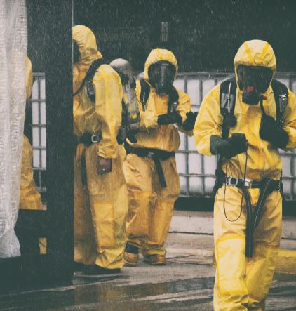

Chemical Emergency
Surge Annex
Tabletop Exercise
Coalition Name
Date
Template provided by:

Slide 2
Instructions for Use of this PPT Template – Delete this slide prior to presentation
Edit these slides based on changes made by the
Exercise Planning Team to the Situation Manual
Template.
Language and information included here is
based on the template design and template
sample language.
Instructions for Use:
Helpful hints are included in these call-out boxes. Delete these prior to your presentation.
[delete prior to presentation]

Slide 3
Welcome and Introductions
Instructions for Use:
Add coalition or jurisdiction logo or seal to customize
[delete prior to presentation]
Name
Agency / Facility
Position / Role

Slide 4
Agenda
Time | Topic
8:00 AM – 8:30 AM | Introductions and opening remarks
8:30 AM – 9:00 AM | Overview of the HCC Chemical Emergency Surge Annex/ process during a large-scale chemical incident
9:00 AM – 9:40 AM | Module 1 – Initial Recognition and Response
9:40 AM – 10:00 AM | Module 2 – Community Coordination and Collaboration
10:00 AM – 10:10 AM | BREAK
10:10 AM – 10:30 AM | Module 2 (continued)
10:30 AM – 11:10 AM | Module 3 – Ongoing Healthcare Coordination
11:10 AM – 11:50 AM | Wrap up and hotwash
Notes:
Today’s event has two purposes. We will provide a brief overview of the HCC Chemical Emergency Surge Annex to ensure all players have a general understanding of its content. Then we will conduct a tabletop exercise (TTX). The TTX is composed of three modules consisting of an initial incident and then the subsequent aftermath. Players in this exercise will participate in the following exercise module elements:
Module 1 – Initial Recognition and Response
Module 2 – Community Coordination and Collaboration
Module 3 – Ongoing Healthcare Coordination
Each module begins with a scenario update that summarizes the key events occurring within that time period. A series of questions following the scenario summary will guide the facilitated discussion of critical issues in each of the modules. Based on exercise priorities, time dedicated to each module will be managed by the facilitator.
Planning Note: Planners may change the event, or scope, as needed to fit local considerations. Scenarios should still follow the modular approach in this sample.

Slide 5
Administrative Details
Restrooms
Fire Exits
Cell Phone Use
Materials

Slide 6
Introduction to HCC Chemical Emergency Surge Annex
Instructions for Use:
Slides 6-8 describe the HCC Chemical Emergency Surge Annex and must be filled in by the Exercise Planning Team based on the specific information in the HCC annex. Feel free to add additional slides to the briefing.
[delete prior to presentation]
Goal REVIEW YELLOW BOX
Scope
Purpose

Slide 7
Planning Assumptions
Instructions for Use:
To be completed by the Exercise Planning Team.
The plans may be in evolution / draft at this point – the attendees should understand that this exercise is designed to help explore, validate, and deconflict the chemical emergency plans in place. We don’t expect to have all the answers at this point.
[delete prior to presentation]
Add Assumptions
Add Assumptions

Slide 8
Triggers or Coalition-Specific Response Steps
Instructions for Use:
To be completed by the Exercise Planning Team.
Describe the thresholds or potential triggers for annex use, as well as the specifics of the response by the coalition members / disciplines.
[delete prior to presentation]
Insert Triggers
Specific Response Steps

Slide 9

Tabletop Exercise
Chemical Emergency Surge Annex

Slide 10
Exercise Scope
This TTX is a half-day interactive, discussion-based exercise focusing on impacts to healthcare coalitions (HCCs) and healthcare facilities caused by the accidental release of a hazardous chemical substance.
The scenario uses an industrial chlorine incident to help jurisdictions anticipate specific issues related to patient surge, decontamination, and medical care needs that may create competing resource and coordination demands.
The objective of this exercise is to focus on the healthcare aspects of the response (e.g., screening/caring for the exposed, or potentially exposed) to test the HCC Chemical Emergency Surge Annex and understand plans and existing gaps at the coalition and coordination level.
Notes:
Planners may change the incident, or scope, as needed to fit local considerations (e.g., a rail-related incident could be substituted for an industrial release).
Planners can adjust patient numbers and add other demographic or geographic information specific to their community to exceed day-to-day capabilities that test and/or “break” the system.
The number of chemically exposed, or potentially exposed, patients should overwhelm area capabilities without being so extreme that they are unrealistic and cause participants to lose focus on issues that do not contribute to functional planning.
The Facilitator has license to adjust patient volumes during the exercise to move the exercise forward.

Slide 11
HPP Program Capabilities Tested
Instructions for Use:
Add or change based on exercise planning at the HCC level. Adjust width of main text box.
[delete prior to presentation]
Capability 2: Healthcare and Medical Response Coordination
  Objective 1: Develop and Coordinate Health Care Organization and Health Care Coalition Response Plans
  Objective 3: Coordinate Response Strategy, Resources, and Communications
Capability 3: Continuity of Healthcare Service Delivery
  Objective 3: Maintain Access to Non-Personnel Resources during an Emergency
  Objective 5: Protect Responders’ Safety and Health
  Objective 6: Plan for and Coordinate Health Care Evacuations and Relocation
Capability 4: Medical Surge
  Objective 1: Plan for a Medical Surge
  Objective 2: Respond to a Medical Surge

Slide 12
Exercise Objectives
Instructions for Use:
Other objectives identified by the Exercise Planning Team. Adjust width of main text box.
[delete prior to presentation]
Review existing chemical emergency care assets and identify gaps that may occur during a chlorine explosion mass casualty incident.
Review agency/facility role during a chemical incident.
Validate assumptions in the HCC Chemical Emergency Surge Annex.
Identify changes that need to be made in the HCC Chemical Emergency Surge Annex based on the roles and capabilities of the involved partners.
[Other objectives identified by the Exercise Planning Team.]

Slide 13
Guidelines
Open, low-stress, no-fault discussion environment.
Comments will be non-attributable.
Be professional and respect other’s opinions based on their knowledge.
Responses should be based on knowledge of current plans and capabilities- you do not have to have all the answers.
Decisions are not precedent setting.
Problem-solving efforts should be the focus – more questions than answers may be generated.
The situation updates, written material, and resources provided are the basis for discussion.
Participants are encouraged to use the SitMan as a reference and to fill out the Participant Feedback Form as you go; feedback is welcome!
Use notes pages available in the SitMan.

Slide 14
Assumptions and Artificialities
During this exercise, the following apply:
The scenario for this exercise is artificial, however, it is plausible, and events occur as they are presented.
There is no “hidden agenda” and there are no “trick questions.”
All players receive information at the same time.
Assume cooperation and support from other responders, agencies, and organizational entities.
Notes:
Planners should be familiar with the chemical guidelines that are specific to their jurisdictional state or local chemical emergency response plan

Slide 15
Module 1: Initial Recognition and Response
Monday morning, 8:00 am
Hospitals and other healthcare facilities served by your HCC are at normal staffing/supply levels early in the morning.
Hospitals were at average daily occupancy for both general inpatient and ICU beds yesterday and into the evening.
You are notified by local EMS that an explosion occurred at a chemical manufacturing plant. The location is in an industrial area, but the adjacent area is densely populated with office buildings, retail spaces, schools.
Initial fire reports indicate a significant chemical release, multiple injuries. But the specific chemical is not confirmed.
Local EMS begin transferring wounded to all nearby medical facilities
Within minutes patients arrive to your facility with a variety of major and minor traumas, respiratory issues, and burns/skin irritations.
Notes:
Scenario Note: While specific numbers are not indicated, the patient load for this portion of the scenario should remain manageable so that it taxes a healthcare system but does not overwhelm it. Small/rural coalitions may adjust their numbers depending on the appropriate scale for their facility and can select a different venue/location based on what is relevant locally.
.

Slide 16
Module 1: Discussion Questions
What are your initial actions upon notification of the explosion? Do you know/understand your role during an industrial chemical incident? Prioritize those actions.
    Are these actions in accordance with coalition, healthcare system, hospital/facility chemical emergency response plan(s)?
If the HCC has an operations center, how is it activated and staffed and what functions does it serve during a chemical emergency? How does it interface with the Emergency Operations Center (EOC)? How is EMS/healthcare (ESF-8) represented at the EOC?
Do you know who your local, regional, and/or national chemical/HAZMAT and poison control resources are and how to contact them?
    Does your jurisdiction have specialized HAZMAT and/or decontamination resources? Does your state have a Hazardous Materials Safety Assistance Team (HMSAT) or Civil Support Team (CST) ?
    Do you know if your State/local health department has disaster epidemiology capacity to assist?
What specialized resources/supplies will be needed to respond to a chemical incident? What is the role of the HCC in acquiring these resources?
    What decontamination equipment and capability do hospitals have?
    Is there a protocol or are processes in place for resource sharing among coalition members and jurisdictional healthcare facilities?
Notes:
This section requires coalition partners to understand their current resources as informed by a gap analysis or risk assessment. The following should be considered when shaping this module:
Who are the specialists able to provide hazardous material response support in your area?
What other regional resources are required and available within your jurisdiction (e.g., HAZMAT experts, toxicologists, industry experts), and how would they be accessed?

Slide 17
Module 1 Discussion Questions (cont.)
Are facility staff familiar with proper chemical emergency response protocol such as screening, triage, contamination control, decontamination, workforce safety, and medical treatment for exposed or potentially exposed individuals?
    Where would you obtain guidance or additional clinical advice if needed, in real time?
Is additional just-in-time training needed and readily available? Where is it located? Who conducts the training?
Who initiates information sharing for HCC members? What alerts and notification mechanisms are in place to ensure HCC members and partners are aware of the incident and can share real-time information about the disaster and plans/strategies for patient care/ transport/distribution/ decontamination/supplies?
    What essential elements of information will you collect from and share with HCC members?
    Who will ensure that up-to-date information about the agent and corresponding treatment recommendations are shared with EMS and hospitals?
Are there any at-risk populations that must be considered such as pediatric patients, those with access or functional needs, or the elderly? How will cultural beliefs that may prevent undressing for decontamination be addressed?

Slide 18

Module 1 Report Out
Each table provides top three lessons, due outs, action items.
Provide the rest of your notes to the exercise facilitator.
Please select a team scribe with legible handwriting.
Notes:
Supply those who will report out with a note pad and pen/ pencil at the beginning of the exercise and assign a scribe for each report out team, preferably someone whose handwriting can be read.

Slide 19

Module 2: Community Coordination and Collaboration
Monday late morning, 10:00 am (Incident + 2 hours)
By 10am it’s verified the explosion was caused by faulty equipment. It was accidental, and the chemical of concern is chlorine gas.
Aside from a high number of injuries, impacts to those in the immediate area, plume models show that an xxx area/radius may be affected. A shelter-in-place order is issued, and the plant has been evacuated.
The governor declares a state of emergency to support disaster services.
News and social media outlets are reporting on the health concerns related to chlorine gas exposure and urging anyone affected to seek care.
911 operators and Poison Control Centers are overwhelmed with calls from those concerned about exposure.
Hospitals, clinics, physician offices, other facilities are receiving symptomatic self-referred patients and EMS transports that were near the site as well as individuals concerned about potential exposure.
You received patients with burn, major/minor trauma, respiratory distress, and self-evacuated individuals, as well as uninjured concerned citizens. Capacity is becoming overwhelmed as more victims present with respiratory irritation.
Notes:
(Note: While specific patient load numbers have been indicated for this module, facilities should adjust numbers so that the focus is NOT on the surge or patient/resource movement, but more specifically on managing high numbers of concerned citizens and evaluating patients for contamination/decontamination).
This section requires coalition partners to have situational awareness about their current surge capacity protocol. The following should be considered when shaping this module:
How would exposure, burn, injury referrals be prioritized, particularly across multiple facilities (e.g., by radiation exposure level and trauma combination injuries, more severely injured, or those with other trauma injuries)?
Where are additional support services, resources, and staff coming from?
Who is controlling risk communication messaging?

Slide 20
Module 2: Discussion Questions
Who decides and communicates shelter-in-place or evacuation orders to the community? How would a hospital be informed of those orders? What actions would a hospital take if it was in the affected zone?
What plans does your facility have for a large number of contaminated, or potentially contaminated, patients? Is there an alternate area for triage/assessment? Do you have the ability to provide ‘dry’ decontamination (i.e., clothing removal, dry absorbent material for blotting skin, redress)?
What EMS transport resources are available for emergency and patient transfer (consider both public safety and private services including local, mutual aid, and state resources and/or ambulance strike teams)?
    Encourage EMS to discuss considerations related to both ground and air assets.
What type of additional assistance and resources are needed now that the surge capacity threshold is being exceeded (e.g., extra staff, space, specialty resources/equipment)? How does the HCC and its members support these needs? Are there other partners that you should coordinate with?
Notes:
Questions in this module may be changed based on coalition resources. The focus is to define the activities that occur (e.g., does transfer coordination occur at the hospital [particularly if there are only one/few hospitals in the coalition], jurisdictional EOC, coalition physical or virtual coordination center, or at the receiving hospital?).
Coalition partners should know their current surge capacity protocol. Discuss:
How will patients be prioritized for care and/or patient movement if load-balancing is required (e.g., by chlorine exposure level/type and trauma combination injuries, by severity of injury, or by other trauma injury types?).
Where will additional support services, resources, and staff come from?
Who has primary responsibility for risk communication?

Slide 21
Module 2: Discussion Questions (cont.)
If a surge of concerned citizens require additional screening areas or treatment spaces (e.g., community screening centers, alternate care sites) how is that initiated?
    Who decides if a reception/screening center is activated? Who will operate the community reception center?
    When/how would this be coordinated, managed, supplied? How will the community screening site be staffed?
    Can dry or wet decontamination be provided on-site if needed?
How is HCC clinical and surge information being collected and distributed (e.g., via email, a special portal, messaging boards) to ensure consistent care and guidance is communicated across facilities?
    Are data and subjective information being collected and reported for situational awareness (e.g., hospital capacity, number exposed, transport needs, supply requests)?
    How will the HCC coordinate and share patient information across multiple facilities for patient tracking and family re-unification?
With public concern high, who is coordinating messaging to the public? What are the key messages?
    How will the EOC Joint Information Center (JIC) coordinate public information with HCC members?
    How will you ensure clear and consistent risk communication messaging to the public and media to prevent/mitigate mass panic?
    Are there readily available chemical release/sheltering-in-place/evacuation scripts available for patients, staff, public messaging?

Slide 22
Module 2 Report Out
Each table provides top three lessons, due outs, action items.
Provide the rest of your notes to the exercise facilitator.
Please select a team scribe with legible handwriting.
Notes:
Supply those who will report out with a note pad and pen/ pencil at the beginning of the exercise and assign a scribe for each report out team, preferably someone whose handwriting can be read.

Slide 23
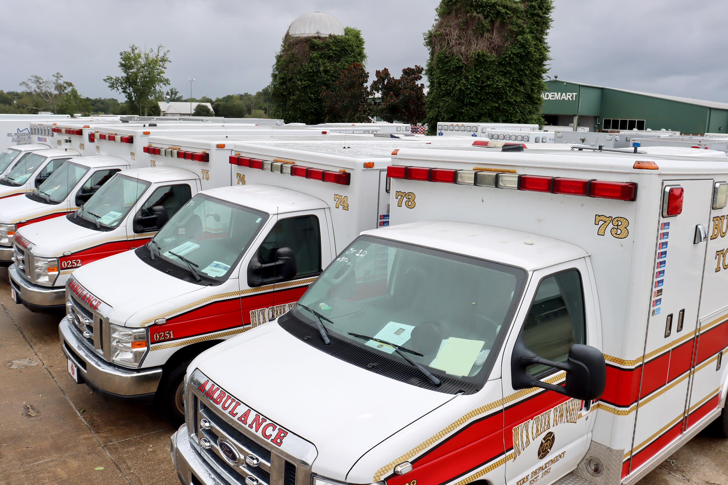
Module 3: Ongoing Healthcare Coordination
Monday evening, 8:00 pm and beyond (Explosion + 12 hrs)
Danger from the plume is over and the shelter-in-place order has been lifted.
The number of new patients presenting has decreased slightly but media coverage remains intense leading to ongoing emergency department burden to conduct exams.
A community reception center remains open to support screening of concerned residents.
Patients suffering from chlorine exposure (e.g., minor/major traumas, burns, other injuries) were stabilized but may now require secondary transfer for ongoing care. Some will need to be cared for locally until transport/inpatient capacity catches up.
Specialty (critical care) transportation resources are also needed for patient movement.
The medical examiner needs guidance on the decontamination of decedents.
Hospitals/EMS have clothing/belongings they’re not sure can be returned. Victims are asking for belongings from the decontamination process.
Mental health/wellness experts warn of negative mental health impacts.
Notes:
This module focuses on the healthcare response to the chemical incident. Exercise Planners can choose to create sub modules, or adjust the scenario, if they prefer to have more detailed discussions regarding post-exposure operations, law enforcement investigations, or other non-medical activities

Slide 24
Module 3: Discussion Questions
You have intubated many patients for airway inflammation that you cannot accommodate- how would you expand capacity at your hospital and/or coordinate referring those cases to a facility that has appropriate capacity and resources?
    What is the current referral process and how would this change for this incident?
    How will you prioritize/triage multiple referrals from your facility?
    What transportation resources will you need?
Does the HCC have a coordination role at this point? What is it? If not, who is coordinating healthcare resource issues?
What experts will hospitals work with to address contaminated belongings and low-level contamination if needed?
What types of staffing shortages and resource needs are likely to occur and how can the HCC help to address them? How many hospital staff, especially in the ER, have been properly trained for a chemical emergency response?
For materials and waste that require special disposal, what partners can support the exponential increased need for collection and disposal of contaminated materials?

Slide 25
Module 3: Discussion Questions (cont.)
Who do hospitals need to notify if they have conducted ‘wet’ decontamination activities that resulted in contaminated water moving into sanitary or storm sewers?
How will patients be tracked? Does the tracking mechanism support family reunification efforts?
What is the process for providing ongoing situational awareness communication among the HCC and jurisdictional health facilities/partners that includes up to date capacity, patient transport, and treatment guideline information?
What is your communication strategy to alleviate public fear and misinformation?
What efforts can be made to divert concerned but not exposed residents to seek medical attention at facilities other than hospital settings?
What mass fatality management plans are in place to support a large-scale incident. What considerations should be made for storing and final disposition of contaminated bodies? What is the role of funeral homes for contaminated remains?

Slide 26
Module 3 Report Out
Each table provides top 3 lessons, due outs, action items.
Provide the rest of your notes to the exercise facilitator.
Please select a team scribe with legible handwriting.
Notes:
Supply those who will report out with a note pad and pen/ pencil at the beginning of the exercise and assign a scribe for each report out team, preferably someone whose handwriting can be read.

Slide 27

Wrap Up
Closing comments

Slide 28

Hotwash
Instructions for Use:
An alternate option to the immediate feedback requested from participants can be to ask each participant to provide “3 Ups” (what worked well) and “3 Downs” (areas of improvement)
[delete prior to presentation]
Immediate feedback from participants
  One positive about the exercise (something you learned, something you can implement immediately)
  One item of correction or action from the exercise (something you would like to take back for immediate action)
Participants should fill out the Participant Feedback Form and submit it before they leave TODAY.

Slide 29

Next Steps
Instructions for Use:
Suggested next steps. Update as appropriate.
[delete prior to presentation]
Each participant/facility should prepare their own action items to close any noted gaps, in addition to the coalition-wide After Action Report and Improvement Plan
Compile notes and comments, and produce an After-Action Report and Improvement Plan
Share Improvement Plan with coalition members and any entity with an action item
Implement action items in the Improvement Plan such as updating plans, and address any training or equipment needs
Notes:
Exercise Planning Team can add additional next steps and the facilitator should recap the action steps discussed in the hotwash

