Slide 1


Infectious Disease Surge Annex
Tabletop Exercise
Coalition Name
Date
Template provided by:

Slide 2
Instructions for Use of this PPT Template – Delete this slide prior to presentation
Edit these slides based on changes made by the
Exercise Planning Team to the Situation Manual
Template.
Language and information included here is
based on the template design and template
sample language.
Instructions for Use:
Helpful hints are included in these call-out boxes. Delete these prior to your presentation.
[delete prior to presentation]

Slide 3
Welcome and Introductions
Instructions for Use:
Add coalition or jurisdiction logo or seal to customize
[delete prior to presentation]
Name
Agency / Facility
Position / Role

Slide 4
Agenda
Time | Topic
8:00 AM – 8:30 AM | Introductions and opening remarks
8:30 AM – 9:00 AM | Overview of the HCC Infectious Disease Surge Annex/ process during an infectious disease incident
9:00 AM – 9:40 AM | Module 1 – Initial Recognition and Response
9:40 AM – 10:00 AM | Module 2 – Community Information Sharing and Coordination
10:00 AM – 10:10 AM | BREAK
10:10 AM – 10:30 AM | Module 2 continued
10:30 AM – 11:10 AM | Module 3 – Ongoing Healthcare Coordination
11:10 AM – 11:50 AM | Wrap up and hotwash
Notes:
Today’s event has two purposes. We will provide a brief overview of the HCC Infectious Disease Surge Annex to ensure all players have a general understanding of its content. Then we will conduct a tabletop exercise (TTX). The TTX is composed of three modules consisting of an initial incident and then the subsequent aftermath. Players in this exercise will participate in the following exercise module elements:
Module 1 – Initial Recognition and Response
Module 2 – Community Information Sharing and Coordination
Module 3 – Ongoing Healthcare Coordination
Each module begins with a scenario update that summarizes the key events occurring within that time period. A series of questions following the scenario summary will guide the facilitated discussion of critical issues in each of the modules. Based on exercise priorities, time dedicated to each module will be managed by the facilitator.
Planning Note: Planners may change the event or the scope as needed to fit local considerations. Scenarios should still follow the modular approach in this sample.

Slide 5
Administrative Details
Restrooms
Fire Exits
Cell Phone Use
Materials

Slide 6
Introduction to HCC Infectious Disease Surge Annex
Instructions for Use:
Slides 6-8 describe the HCC Infectious Disease Surge Annex and must be filled in by the exercise planning team based on the specific information in the HCC annex. Feel free to add additional slides to the briefing.
[delete prior to presentation]
Goal
Scope
Purpose

Slide 7
Planning Assumptions
Instructions for Use:
To be completed by the Exercise Planning Team.
The plans may be in evolution / draft at this point – the attendees should understand that this exercise is designed to help explore, validate, and deconflict the infectious disease plans in place. We don’t expect to have all the answers at this point.
[delete prior to presentation]
Add Assumptions
Add Assumptions

Slide 8
Triggers or Coalition-Specific Response Steps
Instructions for Use:
To be completed by the Exercise Planning Team.
Describe the thresholds or potential triggers for annex use, as well as the specifics of the response by the coalition members / disciplines.
[delete prior to presentation]
Insert Triggers
Specific Response Steps

Slide 9
Tabletop Exercise
Infectious Disease Surge Annex

Slide 10
Exercise Scope
This TTX is an interactive, discussion-based exercise focusing on impacts to healthcare coalition and healthcare facilities caused by large numbers of patients seeking healthcare following exposure to an infectious agent.

Slide 11
HPP Program Capabilities Tested
Instructions for Use:
Add or change based on exercise planning at the HCC level. Adjust width of main text box.
[delete prior to presentation]
Capability 2: Health Care and Medical Response Coordination
Objective 3: Coordinate Response Strategy, Resources, and Communications
Capability 3: Continuity of Health Care Service Delivery
  Objective 3: Maintain Access to Non-Personnel Resources during an Emergency
Capability 4: Medical Surge
  Objective 1: Plan for a Medical Surge
  Objective 2: Respond to a Medical Surge

Slide 12
Exercise Objectives
Instructions for Use:
Other objectives identified by the Exercise Planning Team. Adjust width of main text box.
[delete prior to presentation]
Review existing infectious disease care assets and identify gaps that may occur in an infectious disease-related mass casualty incident.
Review agency/facility role in an infectious disease incident.
Validate assumptions in the HCC Infectious Disease Surge Annex.
Identify changes that need to be made in the HCC Infectious Disease Surge Annex based on the roles and capabilities of the involved partners.

Slide 13
Guidelines
Open, low-stress, no-fault discussion environment.
Comments will be non-attributable.
Be professional and respect other’s opinions based on their knowledge.
Responses should be based on knowledge of current plans and capabilities.
  You do not have to have all the answers.
Decisions are not precedent setting.
Problem-solving efforts should be the focus – more questions than answers may be generated.
The situation updates, written material, and resources provided are the basis for discussion.
Participants are encouraged to use the SitMan as a reference and to fill out the Participant Feedback Form as you go; feedback is welcome!
Use notes pages available in the SitMan.

Slide 14
Assumptions and Artificialities
During this exercise, the following apply:
The scenario for this exercise is artificial, however, it is plausible, and events occur as they are presented.
There is no “hidden agenda” or any “trick questions.”
All players receive information at the same time.
Assume cooperation and support from other responders, agencies, and organizational entities.

Slide 15

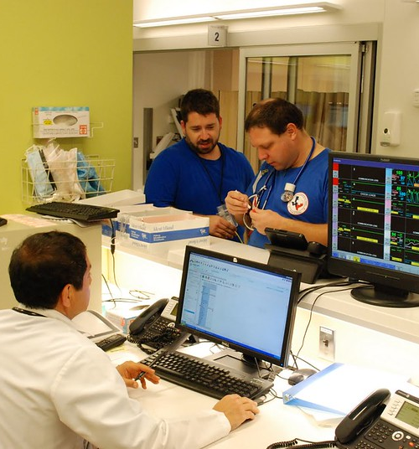
Module 1
Monday morning, 8:00am
Your hospital is at normal staffing and supply levels. Your hospital is at your average daily occupancy.
You are aware that both EMS and hospital emergency departments are unusually busy.
Notification is received from the state health department through the Health Alert Network (HAN).
There is an apparent inhalational anthrax case in a hospital about an hour away in the area served by a neighboring HCC.
Source of exposure is under investigation; several other potential cases have been reported and are being investigated.

Slide 16
Module 1 Discussion Questions
What are your initial actions upon notification of this incident? Would hospitals activate their disaster plans? Do you have an infectious disease surge plan? If yes, how is it activated?
Who initiates information sharing for your HCC members? What alerts and notification mechanisms are in place to ensure that HCC members and partners are aware of the incident and can share initial information about their situation and tactics?
Who has the coordination role at this point? What is it?
How do the HCC and members support this response?
  If the HCC has an operations center, how is it activated and staffed and what functions does it serve? How does it interface with the Emergency Operations Center (EOC)?
  If the HCC functions are conducted by/at the jurisdictional EOC, how rapid is the activation? Who provides coordination and supports the healthcare needs?
  What will be the hours of operation?

Slide 17
Module 1 Discussion Questions (continued)
What essential elements of information will you collect from and share with HCC members?
How is the Emergency Operations Center (EOC) Joint Information Center (JIC) coordinating public information with the HCC(s)?
What specialized resources will be needed to respond to an anthrax attack?
  Are they available within your HCC? If not, how will you acquire them?
  How are SNS assets requested and received both for hospital patient care and public health prophylaxis?
  What is the role of the HCC in acquiring specialized resources?
Where would you obtain guidance or clinical advice for anthrax patient care?

Slide 18
Module 1 Discussion Questions (continued)
Does your regional emerging special pathogen treatment center play a role in this scenario? If yes, how?
How will you ensure adequate resources are available to support the medical response during the concurrent public health response? How do you make resource requests to the State and how are those requests coordinated statewide?
How will you ensure clear and consistent risk communication to the public?
How will you ensure you have adequate supplies and resources to accommodate and support staff (e.g., sleeping accommodations, food and beverages, childcare)?
Will healthcare utilize closed points of distribution for employee prophylaxis if needed? How are these antibiotics obtained and distributed?

Slide 19

Module 1 Report Out
Each table provides top 3 lessons, due outs, action items.
Provide the rest of your notes to the exercise facilitator.
Please select a team scribe with legible handwriting.
Notes:
Supply those who will report out with a note pad and pen/ pencil at the beginning of the exercise and assign a scribe for each report out team, preferably someone whose handwriting can be read.

Slide 20
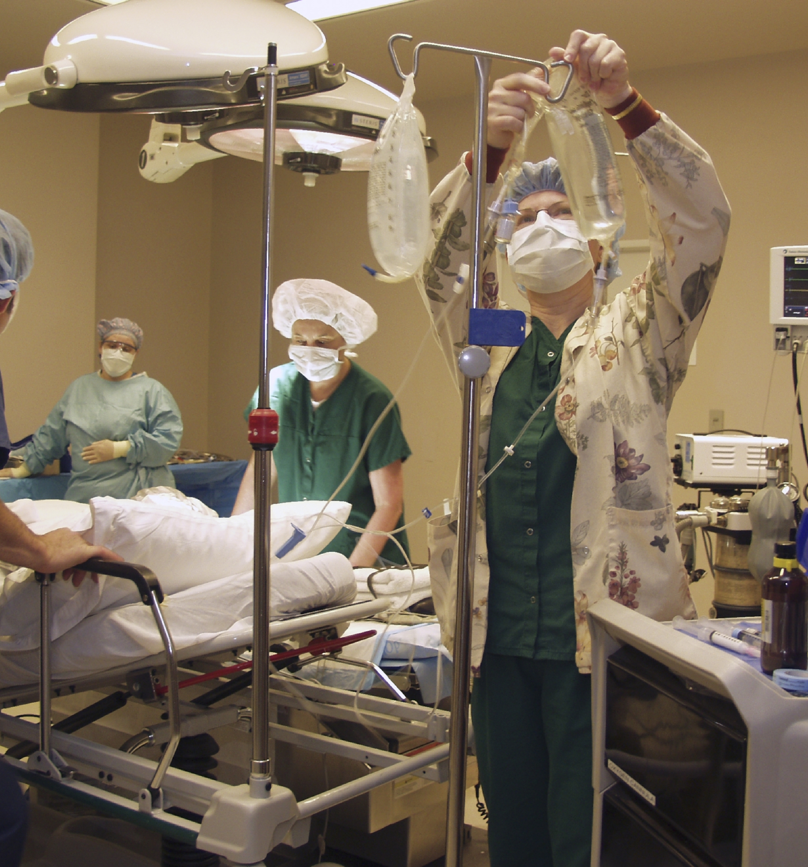
Module 2
Tuesday morning, 8:00am (HAN notification + 24 hours)
A terrorist organization claims responsibility for releasing aerosolized anthrax at a major sporting event Friday afternoon
Widely attended by residents of the state. Additional attacks not known or anticipated.
Governor declared a disaster and state has requested 12-hour Push Packs, scheduled to arrive this morning.
Hospitals, clinics, physician offices, and other healthcare facilities and EMS in the region our HCC serves are experiencing a surge. Includes worried well.
Inpatient beds are 100% capacity and critical care hospital beds are at 120% capacity.
Public health and logistics resources are preparing for the initial distribution of post-exposure prophylaxis.

Slide 21
Module 2 Discussion Questions
What actions do you anticipate taking based on the location of the attack and the potential surge in inpatient demand?
What is the community plan for prophylaxis distribution (open points of distribution) for those in the region that attended the event?
Who has the healthcare coordination role at this point? What is it?
If you have moved or plan to move hospitalized patients to facilities outside the area covered by the HCC, what EMS transport resources are available (both public safety and private services including local, mutual aid, state resources/ ambulance strike teams)?
How can the HCC ensure patient load balancing among hospitals or play a role in transfer decisions? How are hospitals and EMS coordinating this decision making?
If the HCC does not serve in this role, how will interface with state or substate Medical Operations Coordination Cells? What role would they play?

Slide 22
Module 2 Discussion Questions (continued)
How are requests for State and Federal personnel to support healthcare operations coordinated? Will you need to request Federal Medical Stations or use other alternate care sites?
Where will antitoxin treatments from the SNS (Anthim [obiltoxaximab], Anthrasil [anthrax immune globulin], and Abthrax [raxibacumab]) be delivered?
  Who has information about local and federal stockpiles? How do you communicate with them?
  Do you need to ensure continuous refrigeration or will they be kept in the supplied coolers and rapidly used?
  Will the SNS request include the piggyback IV tubing and saline bags needed to administer?
How will the intravenous antibiotics be distributed to hospitals by the State/RSS site? Based on request, pro rata based on size of the facility, or other metrics?
What other treatment products and supporting supplies are you expecting or will you need? How will you request additional ventilators and antibiotics from the SNS?

Slide 23
Module 2 Discussion Questions (continued)
Since patients with mild illness may not be able to be hospitalized due to capacity, will you set up an Alternate Care Site (ACS)?
    How will they be staffed and supplied?
What sites may be suitable to provide antibody infusions to anthrax patients not requiring hospitalization?
How are you triaging patients to distinguish among and appropriately refer the worried well, exposed patients needing post-exposure prophylaxis, and exposed and symptomatic patients who do not need hospitalization?
    How are you managing this process in addition to your usual patient population?
    How are you following up with referred worried well patients? How do you communicate with patient instruction on when to seek medical care?
How are the healthcare facilities managing the increased need for ICU-level care? What is the coalition role?
How will resource allocation decisions in a scarce resource environment be made regionally (e.g., transportation, staff, supplies)?

Slide 24
Module 2 Report Out
Each table provides top 3 lessons, due outs, action items.
Provide the rest of your notes to the exercise facilitator.
Please select a team scribe with legible handwriting.
Notes:
Supply those who will report out with a note pad and pen/ pencil at the beginning of the exercise and assign a scribe for each report out team, preferably someone whose handwriting can be read.

Slide 25
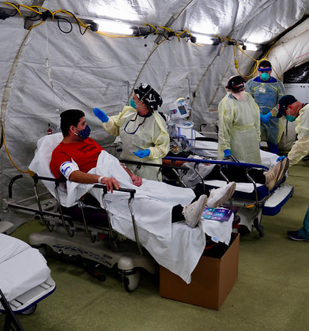
Module 3
Friday morning, 8:00am and beyond (Recognition + 4 days)
The initial distribution of post-exposure prophylaxis is winding down.
Public health agencies are leading the efforts to coordinate distribution of the remaining 60-day course of antibiotics and vaccination of those who were exposed.
Many persons with no connection with the initial event continue to burden EDs.
Number of new patients presenting is declining.
Hospitals remain overwhelmed
Hospitals within the HCC are operating at 200% capacity with very high acuity.
Two federal medical stations staffed by federal staff have been established in the state with general inpatient care.
Multiple different treatment regimens are being used due to relative shortage of meropenem and fluoroquinolones.
Region lacks sufficient ICU capacity though triage of resources is not currently needed.
Several cases of anaphylaxis have occurred after monoclonal antibodies, resulting in at least one fatality.
Hospital supplies of chest tubes, chest tube drainage sets, and lumbar puncture supplies are exhausted at many facilities.

Slide 26
Module 3 Discussion Questions
Does the HCC have a coordination role at this point? What is it? If not, who is coordinating healthcare resource issues?
How will the HCC work towards resupplying or redistributing needed equipment and supplies?
How will the HCC and state coordinate to develop guidance for limiting use of chest tubes and lumbar puncture kits?
What is the HCC’s role in crisis standards of care recommendations?
What types of staffing shortages would occur and how can the HCC help address them?
How are patients being tracked that received prophylaxis or monoclonal antibodies?

Slide 27
Module 3 Discussion Questions (continued)
What role is telemedicine playing in the management of patients? Is telemedicine being used in other ways?
Have any other federal assets (e.g., DMATs, NDMS) in addition to SNS and Federal Medical Stations (FMS) been deployed? Are resources available through the Emergency Management Assistance Compact (EMAC)? How are they being integrated into the response?
If you had not initially transferred patients out of the region to enable load balancing or level loading, is the option being considered?

Slide 28
Module 3 Discussion Questions (continued)
What state and federal emergency authorities and waivers has your HCC been operating under? Are they sufficient to meet your requirements?
What plans and resources are available to support the post-exposure vaccination effort?
What is your communication strategy to alleviate the public fear of anaphylaxis from prophylaxis or monoclonal antibodies?
What efforts can be made to divert worried well to seek medical attention at facilities other than hospital settings?

Slide 29
Module 3 Report Out
Each table provides top 3 lessons, due outs, action items.
Provide the rest of your notes to the exercise facilitator.
Please select a team scribe with legible handwriting.
Notes:
Supply those who will report out with a note pad and pen/ pencil at the beginning of the exercise and assign a scribe for each report out team, preferably someone whose handwriting can be read.

Slide 30

Wrap Up
Closing comments

Slide 31

Hotwash
Immediate feedback from participants
  One positive about the exercise (something you learned, something you can implement immediately)
  One item of correction or action from the exercise (something you would like to take back for immediate action)
Participants should fill out the Participant Feedback Form and submit it before they leave TODAY.

Slide 32

Next Steps
Instructions for Use:
Suggested next steps. Update as appropriate.
[delete prior to presentation]
Each participant / facility should prepare their own action items to close any noted gaps, in addition to the coalition-wide After Action Report and Improvement Plan
Compile notes and comments, and produce an After Action Report and Improvement Plan
Share Improvement Plan with coalition members and any entity with an action item
Implement action items in the Improvement Plan such as updating plans, and address any training or equipment needs
Notes:
Exercise Planning Team can add additional next steps and the facilitator should recap the action steps discussed in the hotwash

