Slide 1
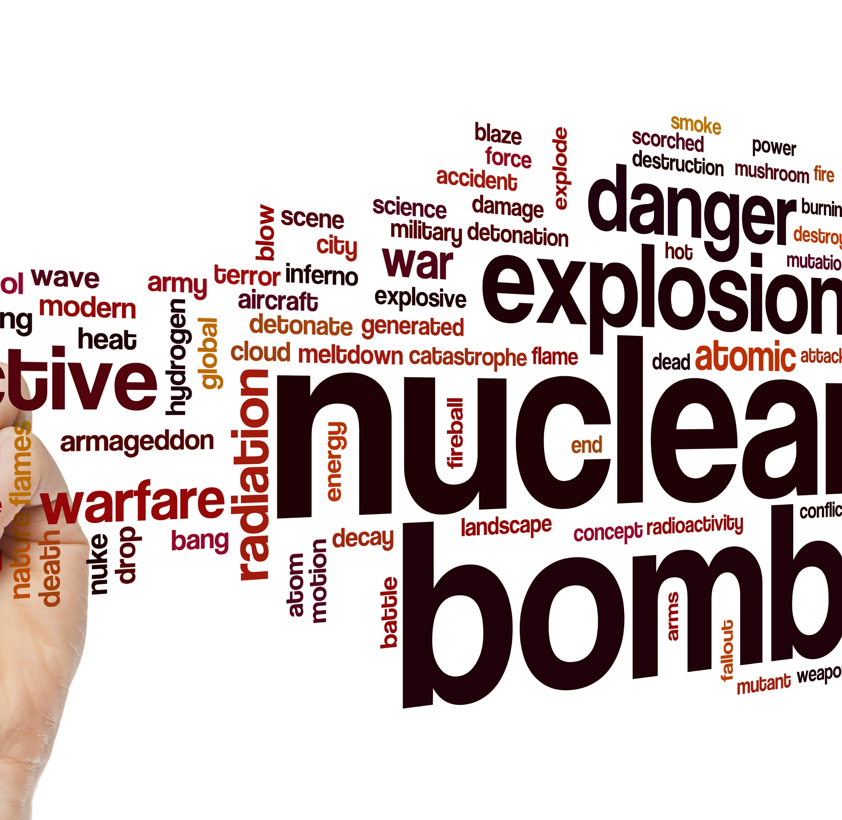

Radiation Emergency Surge Annex
Tabletop Exercise
Coalition Name
Date
Template provided by:

Slide 2
Instructions for Use of this PPT Template – Delete this slide prior to presentation
Edit these slides based on changes made by the
Exercise Planning Team to the Situation Manual
Template.
Language and information included here is
based on the template design and template
sample language.
Instructions for Use:
Helpful hints are included in these call-out boxes. Delete these prior to your presentation.
[delete prior to presentation]

Slide 3
Welcome and Introductions
Instructions for Use:
Add coalition or jurisdiction logo or seal to customize
[delete prior to presentation]
Name
Agency / Facility
Position / Role

Slide 4
Agenda
Time | Topic
8:00 AM – 8:30 AM | Introductions and opening remarks
8:30 AM – 9:00 AM | Overview of the HCC Radiation Emergency Surge Annex/ process during a large-scale radiological incident
9:00 AM – 9:40 AM | Module 1 – Initial Recognition and Response
9:40 AM – 10:00 AM | Module 2 – Community Coordination and Collaboration
10:00 AM – 10:10 AM | BREAK
10:10 AM – 10:30 AM | Module 2 (continued)
10:30 AM – 11:10 AM | Module 3 – Ongoing Healthcare Coordination
11:10 AM – 11:50 AM | Wrap up and hotwash
Notes:
Today’s event has two purposes. We will provide a brief overview of the HCC Radiation Emergency Surge Annex to ensure all players have a general understanding of its content. Then we will conduct a tabletop exercise (TTX). The TTX is composed of three modules consisting of an initial incident and then the subsequent aftermath. Players in this exercise will participate in the following exercise module elements:
Module 1 – Initial Recognition and Response
Module 2 – Community Coordination and Collaboration
Module 3 – Ongoing Healthcare Coordination
Each module begins with a scenario update that summarizes the key events occurring within that time period. A series of questions following the scenario summary will guide the facilitated discussion of critical issues in each of the modules. Based on exercise priorities, time dedicated to each module will be managed by the facilitator.
Planning Note: Planners may change the event or the scope as needed to fit local considerations. Scenarios should still follow the modular approach in this sample.

Slide 5
Administrative Details
Restrooms
Fire Exits
Cell Phone Use
Materials

Slide 6
Introduction to HCC Radiation Emergency Surge Annex
Instructions for Use:
Slides 6-8 describe the HCC Radiation Emergency Surge Annex and must be filled in by the exercise planning team based on the specific information in the HCC annex. Feel free to add additional slides to the briefing.
[delete prior to presentation]
Goal
Scope
Purpose

Slide 7
Planning Assumptions
Instructions for Use:
To be completed by the Exercise Planning Team.
The plans may be in evolution / draft at this point – the attendees should understand that this exercise is designed to help explore, validate, and deconflict the radiation emergency plans in place. We don’t expect to have all the answers at this point.
[delete prior to presentation]
Add Assumptions
Add Assumptions

Slide 8
Triggers or Coalition-Specific Response Steps
Instructions for Use:
To be completed by the Exercise Planning Team.
Describe the thresholds or potential triggers for annex use, as well as the specifics of the response by the coalition members / disciplines.
[delete prior to presentation]
Insert Triggers
Specific Response Steps

Slide 9
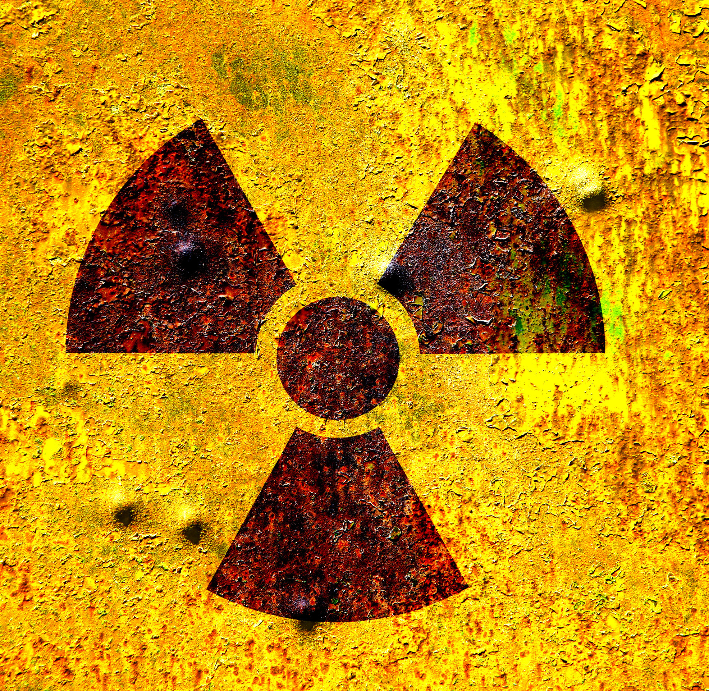
Tabletop Exercise
Radiation Emergency Surge Annex

Slide 10
Exercise Scope
This TTX is an interactive, discussion-based exercise focusing on impacts to healthcare coalitions (HCCs) and healthcare facilities caused by the intentional release of a radiological dispersal device (RDD) resulting in a surge of confirmed and potentially exposed radiological patients.
The scenario portrays a “dirty bomb” incident, and its aftermath, where people who may not need medical treatment but fear they have been exposed (i.e., “worried well”) may overwhelm a health system.
The emphasis is on radiation exposure, the need to assess patients for contamination/decontamination, injuries, and working with public health and emergency managers.
Notes:
Planners should consider adjusting patient numbers and providing any other demographic or geographic information specific to your community and design to exceed day-to-day capabilities that test and/or “break” the system. It is important that the number of radiologically exposed, or potentially exposed, patient volumes overwhelm area capabilities without being so extreme that they are unrealistic and cause participants to lose focus or focus on issues that do not contribute to functional planning. The
Facilitator should have license to adjust patient volumes during the exercise to move the exercise forward.
Rural coalitions with few local hazards may elect to have the scenario occur in another jurisdiction where many individuals may flee from and seek evaluation and care in the rural coalition area.

Slide 11
HPP Program Capabilities Tested
Instructions for Use:
Add or change based on exercise planning at the HCC level. Adjust width of main text box.
[delete prior to presentation]
Capability 2: Healthcare and Medical Response Coordination
  Objective 1: Develop and Coordinate Health Care Organization and Health Care Coalition Response Plans
  Objective 3: Coordinate Response Strategy, Resources, and Communications
Capability 3: Continuity of Healthcare Service Delivery
  Objective 3: Maintain Access to Non-Personnel Resources during an Emergency
  Objective 5: Protect Responders’ Safety and Health
  Objective 6: Plan for and Coordinate Health Care Evacuations and Relocation
Capability 4: Medical Surge
  Objective 1: Plan for a Medical Surge
  Objective 2: Respond to a Medical Surge

Slide 12
Exercise Objectives
Instructions for Use:
Other objectives identified by the Exercise Planning Team. Adjust width of main text box.
[delete prior to presentation]
Review existing radiation emergency care assets and identify gaps that may occur during a radiological mass casualty incident.
Review agency/facility role during a radiological emergency incident.
Validate assumptions in the HCC Radiation Emergency Surge Annex.
Identify changes that need to be made in the HCC Radiation Emergency Surge Annex based on the roles and capabilities of the involved partners.
[Other objectives identified by the Exercise Planning Team.]

Slide 13
Guidelines
Open, low-stress, no-fault discussion environment.
Comments will be non-attributable.
Be professional and respect other’s opinions based on their knowledge.
Responses should be based on knowledge of current plans and capabilities.
  You do not have to have all the answers.
Decisions are not precedent setting.
Problem-solving efforts should be the focus – more questions than answers may be generated.
The situation updates, written material, and resources provided are the basis for discussion.
Participants are encouraged to use the SitMan as a reference and to fill out the Participant Feedback Form as you go; feedback is welcome!
Use notes pages available in the SitMan.

Slide 14
Assumptions and Artificialities
During this exercise, the following apply:
The scenario for this exercise is artificial, however, it is plausible, and events occur as they are presented.
There is no “hidden agenda” and there are no “trick questions.”
All players receive information at the same time.
Assume cooperation and support from other responders, agencies, and organizational entities.
Notes:
Planners may change the incident, or the scope, as needed to fit local considerations. Scenarios should still follow the modular approach in this sample.
Planners should consider adjusting patient numbers and providing any other demographic or geographic information specific to your community and design to exceed day-to-day capabilities that test and/or “break” the system. It is important that the number of radiologically exposed, or potentially exposed, patient volumes overwhelm area capabilities without being so extreme that they are unrealistic and cause participants to lose focus or focus on issues that do not contribute to functional planning. The Facilitator should have license to adjust patient volumes during the exercise to move the exercise forward.
Rural coalitions with few local hazards may elect to have the scenario occur in another jurisdiction where many individuals may flee from and seek evaluation and care in the rural coalition area.
Planners should also be familiar with the radiation guidelines that are specific to their jurisdictional state or local radiation program.

Slide 15
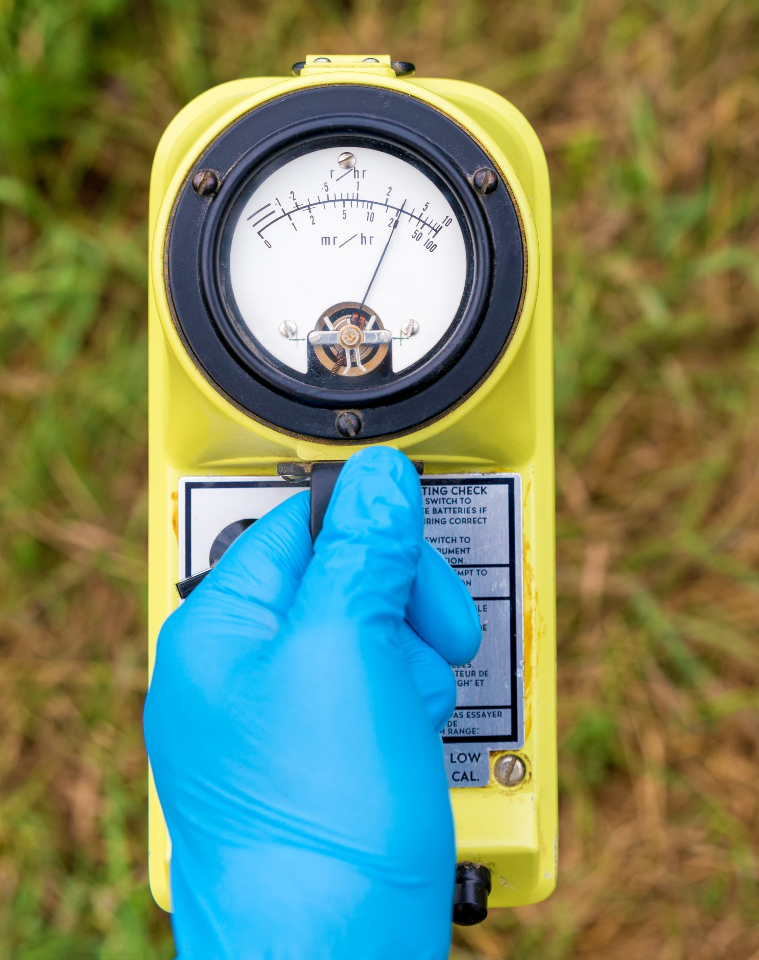
Module 1
Monday Morning, 10:00 am
Your hospital was at normal staffing and supply levels, with average daily occupancy this morning (8:00 am). Hospitals were at average daily occupancy for general inpatient and intensive care unit (ICU) beds.
You are notified by local EMS that a large explosion occurred near a prominent high-rise building downtown. The location is populated by office workers, residents, and tourists.
Within minutes, local EMS begin transferring wounded to all nearby medical facilities for a variety of major/minor traumas including smoke inhalation and burns.
About an hour later, after many patients have been received, you are notified that radiation detectors at the explosion site indicate higher than normal levels of gamma radiation. HAZMAT teams, specialized investigators, and environmental agencies have been dispatched to further investigate. It is unclear if the increased readings are due to a criminal act.
Notes:
Note: While specific numbers are not indicated, the patient load for this portion of the scenario should remain manageable so that it taxes a healthcare system but does not overwhelm it. Small/rural coalitions may adjust numbers depending on the appropriate scale for their facility size- and can select a different venue/location based on what is relevant locally).
This module focuses on the initial health care response to the incident where radiation contamination is not recognized until patients are in the facility. Exercise Planners can create sub modules, or adjust the scenario, if they prefer more detailed discussions regarding pre-hospital emergency operations activities, law enforcement/emergency responder responsibilities, or other non-medical efforts.
.

Slide 16
Module 1 Discussion Questions
What are your initial actions upon notification of the blast? Do you know/understand your role during an emergency? Prioritize those actions if able.
    What initial actions do you anticipate taking based on the location of the attack, potential surge in emergency department, and inpatient demand?
What actions would you take once you learn radiation detectors are going off?
    Is this in accordance with coalition hospital/facility radiological response plans?
If the HCC has an operations center, how is it activated and staffed and what functions does it serve? How does it interface with the Emergency Operations Center (EOC)?
Do you know who your local, regional, and national facility radiological experts are and how to contact them?
    Does your state have a FEMA certified Radiation Operations Support Specialist (ROSS)?
Are facility staff familiar with proper radiological screening, triage, decontamination, and treatment protocol for exposed or potentially exposed individuals?
    Where would you obtain guidance or additional clinical advice if needed, in real time?
Notes:
This section requires coalition partners to understand their current resources as informed by a gap analysis or risk assessment. The following should be considered when shaping this module:
Who are the specialists able to provide radiological exposure care in your area?
What other regional resources are available for care and clinical advice within your jurisdiction (e.g., radiology imaging centers, oncology/hematology facilities, academic research institutes, state/local agencies), how would they be accessed?

Slide 17
Module 1 Discussion Questions (continued)
What specialized resources/supplies are needed to respond to a radiological attack? What is the role of the HCC in acquiring these resources? What other radiological response resources are available within the region?
      What detection equipment do your fire/EMS services have?
      What detection equipment do hospitals have?
      What radiation response equipment does your state have and how will you request it?
      How are SNS assets requested and received if countermeasures are needed?
      Is there protocol, processes in place for resource sharing among coalition members, jurisdictional healthcare facilities?
Is additional just-in-time training needed/supported for specialty care, use of new/unfamiliar equipment (e.g., radiation detection, dosimetry, decontamination equipment)? Is the needed training readily available? Where is it located? Who conducts the training?

Slide 18
Module 1 Discussion Questions (continued)
Who initiates information sharing for HCC members? What alerts and notification mechanisms are in place to ensure that HCC members and partners are aware of the incident and can share real-time information about the disaster and plans/strategies for patient care/ transport/distribution/ decontamination/supplies?
What essential elements of information will you collect from and share with HCC members?

Slide 19

Module 1 Report Out
Each table provides top three lessons, due outs, action items.
Provide the rest of your notes to the exercise facilitator.
Please select a team scribe with legible handwriting.
Notes:
Supply those who will report out with a note pad and pen/ pencil at the beginning of the exercise and assign a scribe for each report out team, preferably someone whose handwriting can be read.

Slide 20
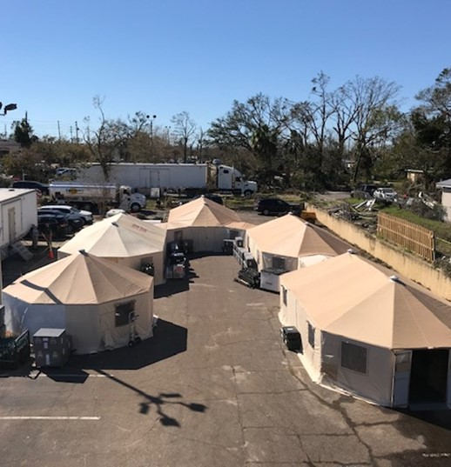
Module 2
Monday Afternoon, (radiation identification + 2 hours)
By 12:00 pm it is verified the explosion was caused by a Radiological Dispersal Device (RDD) (i.e., a “dirty bomb”). Investigators confirm the device contained cesium-137.
Physical damage confined to the front of several buildings and their facing interiors. That block and a three-block downwind area are cordoned and evacuated; their surface contamination levels exceed 10mrem/h, with higher levels at the site of the detonation.
12 persons are dead at the scene, about 60 require hospitalization, and about 100 are being evaluated for minor injuries.
A state of emergency is declared to support federal requests for Strategic National Stockpile (SNS) assets, additional disaster services.
News/social media outlets report the device was “radioactive;” 911 operators/Poison Control Centers are inundated with calls.
Healthcare facilities are beginning to see patients and EMS transports of people who were nearby and now worried about potential contamination.
Notes:
(Note: While specific patient load numbers have been indicated for this module, facilities should adjust numbers so that the focus is NOT on the surge or patient/resource movement, but more specifically on managing high numbers of worried well and evaluating patients for contamination/decontamination).
This section requires coalition partners to have situational awareness about their current surge capacity protocol. The following should be considered when shaping this module:
How would exposure, burn, injury referrals be prioritized, particularly across multiple facilities (e.g., by radiation exposure level and trauma combination injuries, more severely injured, or those with other trauma injuries)?
Where are additional support services, resources, and staff coming from?
Who is controlling risk communication messaging?

Slide 21
Module 2 Discussion Questions
Do the HCC and its members response activities change now that this is a confirmed intentional radiological attack?
Who has the healthcare coordination role at this point? What is it?
Who is coordinating messaging to the public? What are the key messages to get out?
Who has responsibility for community screening locations for persons that are worried about contamination?
How are you triaging patients to distinguish among those needing medical evaluation, those needing community-based screening, and those that do not need screening?
    Who will operate the community reception center? When/how would those be coordinated, managed, supplied?
    How will hospitals assess their current patients for contamination? How will hospitals triage and refer those that are seeking contamination assessment only?
Do facility staff understand plans for contamination control and workforce safety/exposure protocols?
Do the hospitals have a plan for evaluating those patients with significant contamination for radiation injury and internal contamination (e.g., CBC+Diff for ALC counts and use of stool/urine monitoring)? If not, who will they work with to obtain these?
Notes:
These questions may need to be changed based on coalition resources. The key focus of this module is defining what activities occur where (e.g., does transfer coordination occur at the hospital [particularly if there are only one/few hospitals in the coalition], jurisdictional Emergency Operations Center [EOC], coalition physical or virtual coordination center, or receiving hospital).
Determine whether to add any at-risk populations to the patient mix, such as pediatric patients or those with access or functional needs.

Slide 22
Module 2 Discussion Questions (continued)
What is the EMS plan for local distribution of casualties (e.g., what patients go to which hospitals if there are multiple ones receiving varying levels of trauma)? What is their capacity? What are their treatment limits (e.g., not a level-1 trauma center, unable to receive high number of respiratory distress patients, specialize in burn care)?
What special considerations affect EMS patient transportation resources during a radiological emergency (e.g., EMS restrictions related to transportation and care of radiological casualties)?
How will the community reception center (radiological screening site) be staffed? Where will radiological screening equipment be sourced from?
How will requests for chelating agents such as Prussian Blue (PB) from SNS be made? Where will they be delivered?
    Who has information about local/federal stockpiles? How do you communicate with them?
    Will supplies require special storage conditions or security protocol?
    Is there a toxicologist with experience/knowledge for using PB available?
What agencies/contractors will the hospitals work with to address contaminated waste and low-level contamination of some tile floors that are not responding to usual clean up procedures?

Slide 23
Module 2 Discussion Questions (continued)
How is the EOC Joint Information Center (JIC) coordinating public information with the HCC(s)?
    How will you ensure clear and consistent risk communication messaging to the public and media to prevent/mitigate mass panic?
    Are there readily available RDD information packets/scripts available for patients and staff?
How will you address provider/public safety information needs to ensure that workers feel safe? (Note that only trivial levels of radiation have been detected outside of the cordoned area).
How is HCC clinical and surge information being collected and distributed (e.g., via email, special portal, messaging boards) to ensure consistent care and guidance across facilities?
    Are special reporting requirements, metrics, or data being collected for situational awareness (e.g., hospital capacity, number exposed, transport needs, supply requests)?
    How will the HCC coordinate and share patient information across multiple facilities for patient tracking and family re-unification?

Slide 24
Module 2 Report Out
Each table provides top three lessons, due outs, action items.
Provide the rest of your notes to the exercise facilitator.
Please select a team scribe with legible handwriting.
Notes:
Supply those who will report out with a note pad and pen/ pencil at the beginning of the exercise and assign a scribe for each report out team, preferably someone whose handwriting can be read.

Slide 25
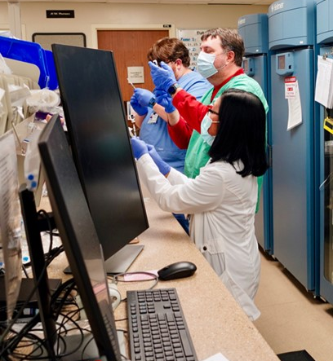
Module 3
Tuesday Morning, 8:00 am and beyond (Recognition + 14 hours)
By 12:00 pm it is verified the explosion was caused by a Radiological Dispersal Device (RDD) (i.e., a “dirty bomb”). Investigators confirm the device contained cesium-137.
Physical damage confined to the front of several buildings and their facing interiors. That block and a three-block downwind area are cordoned and evacuated; their surface contamination levels exceed 10mrem/h, with higher levels at the site of the detonation.
12 persons are dead at the scene, about 60 require hospitalization, and about 100 are being evaluated for minor injuries.
A state of emergency is declared to support federal requests for Strategic National Stockpile (SNS) assets, additional disaster services.
News/social media outlets report the device was “radioactive;” 911 operators/Poison Control Centers are inundated with calls.
Healthcare facilities are beginning to see patients and EMS transports of people who were nearby and now worried about potential contamination.
Notes:
(Note: While specific patient load numbers have been indicated for this module, facilities should adjust numbers so that the focus is NOT on the surge or patient/resource movement, but more specifically on managing high numbers of worried well and evaluating patients for contamination/decontamination).
This section requires coalition partners to have situational awareness about their current surge capacity protocol. The following should be considered when shaping this module:
How would exposure, burn, injury referrals be prioritized, particularly across multiple facilities (e.g., by radiation exposure level and trauma combination injuries, more severely injured, or those with other trauma injuries)?
Where are additional support services, resources, and staff coming from?
Who is controlling risk communication messaging?

Slide 26
Module 3 Discussion Questions
How does the HCC Radiological Emergency Surge Annex address community screening?
Does the HCC have a coordination role at this point? What is it? If not, who is coordinating healthcare resource issues?
How will the HCC, or coordination lead, work towards resupplying or redistributing needed equipment and supplies? How will it ensure proper supply levels are continuously available if response efforts take longer than anticipated?
What types of staffing shortages will occur for long-term response needs (e.g., over weeks) and how can the HCC help to address them? How many hospital staff, especially in the ER, have been REAC/TS trained?
How will you address radiological waste issues; what agencies, partners can support exponential increased need for disposal of contaminated materials?
How will the HCC coordinate with the FBI to retain possible evidence from radiologically contaminated clothing? Where will evidence be stored? How will it be monitored to ensure it does not reach a hazardous level?
How are patients being tracked that were transported or who may need follow-up care, ongoing treatment? Does the tracking mechanism support family reunification efforts?

Slide 27
Module 3 Discussion Questions (continued)
What is the process for providing ongoing situational awareness communication among the HCC facilities, or jurisdictional health facilities, regarding capacity, transported patients, updated treatment guidelines?
What is your communication strategy to alleviate public fear and misinformation? How are mental health services being offered to incident survivors, trauma victims, workforce?
What state and federal emergency authorities and waivers has your HCC been operating under? Are they sufficient to meet your requirements?
    Who is tracking disaster relief administrative needs (e.g., financial assistance, billing/coding issues, reimbursement requirements)?

Slide 28
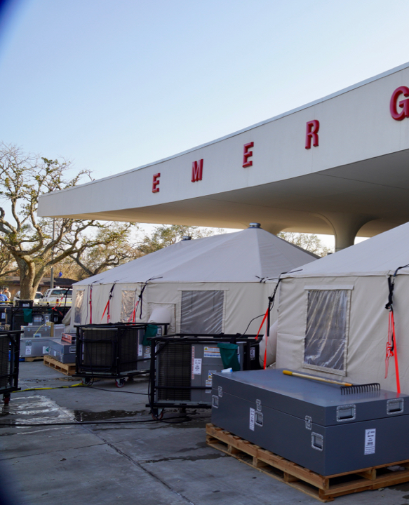
Module 3 Discussion Questions (continued)
How is information being tracked/documented for an after-action report (e.g., issues, gaps, lessons learned)?
What efforts can be made to divert worried well to seek medical attention at facilities other than hospital settings?
What mass fatality management plans are in place to support a large-scale incident? What considerations should be made for storing and disposing of radiologically contaminated bodies?

Slide 29
Module 3 Report Out
Each table provides top 3 lessons, due outs, action items.
Provide the rest of your notes to the exercise facilitator.
Please select a team scribe with legible handwriting.
Notes:
Supply those who will report out with a note pad and pen/ pencil at the beginning of the exercise and assign a scribe for each report out team, preferably someone whose handwriting can be read.

Slide 30

Wrap Up
Closing comments

Slide 31

Hotwash
Instructions for Use:
An alternate option to the immediate feedback requested from participants can be to ask each participant to provide “3 Ups” (what worked well) and “3 Downs” (areas of improvement)
[delete prior to presentation]
Immediate feedback from participants
  One positive about the exercise (something you learned, something you can implement immediately)
  One item of correction or action from the exercise (something you would like to take back for immediate action)
Participants should fill out the Participant Feedback Form and submit it before they leave TODAY.

Slide 32

Next Steps
Instructions for Use:
Suggested next steps. Update as appropriate.
[delete prior to presentation]
Each participant/facility should prepare their own action items to close any noted gaps, in addition to the coalition-wide After Action Report and Improvement Plan
Compile notes and comments, and produce an After-Action Report and Improvement Plan
Share Improvement Plan with coalition members and any entity with an action item
Implement action items in the Improvement Plan such as updating plans, and address any training or equipment needs
Notes:
Exercise Planning Team can add additional next steps and the facilitator should recap the action steps discussed in the hotwash

